Slide 1
Assignment 2
How to select the right Data
(Measurable Indicators)

Slide 2
The Data (Indicators) you choose must be Measurable. Assume the following BI Question - let’s break down the question into key (measurable) variables
1
Let's assume the assignment Key Question is → What is the role of Economic Development and Quality of ICT infrastructure in achieving SDG 10, Reduced Inequalities
How many variables does this questions have? Three – these are
Economic development
Quality of ICT infrastructure
Reduced inequalities
Next step is to find data that we can use to measure and analyze economic development, Quality of ICT infrastructure, and reduced inequalities.

Slide 3
Next step, decompose the key variables into measurable data indicators
2
What data can we use to measure…
Economic Development?
Quality of ICT infrastructure?
Reduced Inequalities?
[eg, GDP per capita, employment rates…what else?]
[eg, internet access, internet speed, broadband & cellphone penetration etc]
[eg, income distribution, gender wage gaps, employment inequality using data on unemployment rates, life expectancy distribution etc ]
Primary question
What is the role of economic development and Quality of ICT infrastructure in achieving SDG 10, Reduced Inequalities

Slide 4
Refine your focus - choosing measurable indicators based on interests or research
3
For instance, you could explore factors affecting health inequality…see examples of measurable indicators for the three key variables below.
Economic Development [eg, GDP per capita, employment rates]
Quality of ICT infrastructure [eg, internet access rates, broadband and cell phone penetration]
Reduced Inequalities [eg, income distribution, gender wage gaps, employment inequality using data on unemployment rates, life expectancy distribution ]
Primary question
What is the role of economic development and Quality of ICT infrastructure in achieving SDG 10, Reduced Inequalities

Slide 5
Consider a quick literature review to identify potential relationships …….
4
What does research say? Example, research shows that low access to e-health, lower levels of education, and unemployment contribute to health inequality.
Economic Development
Quality of ICT infrastructure
Reduced Inequalities
[data to consider – unemployment, GDP, income]
[data to consider – internet access, e-health access]
[data to consider – life expectancy distribution, distribution of infant mortality rate etc]
Primary question
What is the role of economic development and Quality of ICT infrastructure in achieving SDG 10, Reduced Inequalities

Slide 6
Consider a diagrammatic representation of the relationship between the three key variables – helps you visualize the relationships
5
Create a model showing the relationship between
Economic Development and Reduced Inequalities
Quality of ICT infrastructure and Reduced Inequalities
The arrow suggests that economic development influences reduced inequalities? How? does it increase or decrease?
Economic development
?
Reduced inequalities
?
Quality of ICT infrastructure
The arrow suggests that quality of ICT infrastructure influences reduced inequalities? ? How? does it increase or decrease?
The above model suggests that economic development and Quality of ICT infrastructure play a role (influences) Reduced Inequalities
For the BI Question you formulate in the assignment, make sure the key variables are measurable. For example – in the question what has been the trend in global employment rates and GDP growth over the last decade? employment rates can be measured by procuring employment data etc. GDP is measurable also. How about measuring growth? Growth can be measured by comparing employment data over time, has employment increased? That’s growth.

Slide 7
Now ready to analyze the data using Power BI…….
To get started, you can refer to Labs 7 and 8…
Lab 7 covers dimensional modeling
Lab 8 focuses on advanced analysis techniques
To get started, consider using decomposition tree and key influencers tools (see Lab 8) to identify key factors
Scatter plots are great for visualizing relationships
See example from https://www.gapminder.org ….next slide
6

Slide 8
How many graphs…….
How many graphs? The number will depend on the complexity of your data and the story or narrative you want to convey.
However, here is a general guideline.
For each Descriptive, Diagnostic, Predictive Analytics
Aim for a minimum of 2, and idealy 4-6 visualizations
This could include a mix of bar charts, line graphs, scatter plots and maps depending on the insights you are after
Anything to help illustrate the main trends, relationships or forecasts you have identified.
Other examples include a mix of Histogram, bar charts, line graphs (e.g trends over time), pie charts (e.g distribution of public vs private transport, education levels), heat map (e.g. prevalence of smoking across regions) and box plots (e.g life expectancy across countries).
7

Slide 9
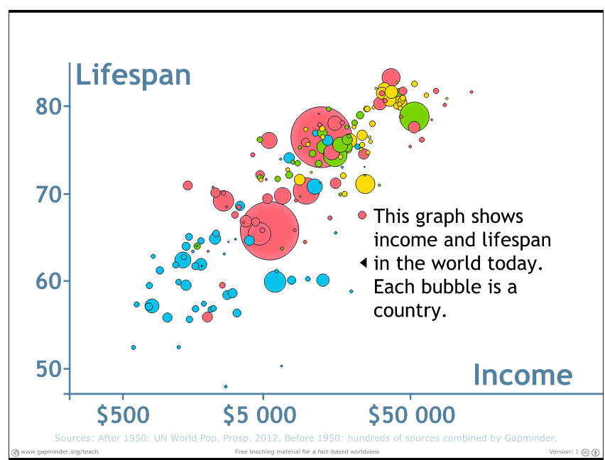
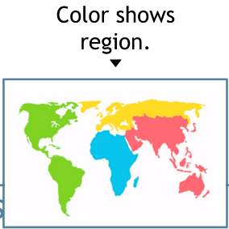
Example of relationship between income and life expectancy
Professor Hans Rosling shows that people live longer in countries with a high GDP per capital
Relationship? - there is a positive relationship between economic development and health outcomes
Insight? – as countries experience higher income/ GDP per capita, they generally have better health outcomes (measured as life-expectancy), leading to a reduction in health inequalities.
Example Insight – what is the relationship between economic development (measured using income distribution, GDP ) and Reduced Inequalities (measured using distribution of life expectancy)?

